Slide 1
Should probably update to an OIT template if anyone has one they can share. This is the VA VEO template. Happy to adjust and leverage this if preferred.
X Project
Status Meeting

Slide 2
Agenda
Priority Items
Review Project Status
Actions & Next Steps
Open Forum

Slide 3
Status Review
Item | Description | Status | Next Steps | Owner
Ad Hoc/Priority Items… | x | x | x | x
Pre-Discovery Research | Review of current process & user flows | x | x | x
Design | x | x | x | x
Testing | x | x | x | x
Refinement

Slide 4
Appendix

Slide 5
Project Overview & Scope
x

Slide 6
Project Timeline
 | Apr 2022 | May | Jun | Jul | Aug | Sep | Oct | Nov | Dec | Jan 2023 | Feb | Mar | Apr
Comms |  |  |  | `
Brand
Digital Listening
Experience Measurements / Dashboard
Reporting
Org Design & Change Mgmt
Leadership Support & Org Strategy
Comms Campaign Support
ORMDI Rebranding
Conscious I-DEA Campaign
UPDATE
ORMDI Re-Naming
D&I2 – D&I Digital Insights Program Support & Weekly Reporting
Dashboard Refinement
Dashboard Support & Maintenance
Quarterly Reporting
Quarterly Reporting
Quarterly Reporting
Quarterly Reporting
Org Refinement
Change Comms & Sponsorship
Change Coaching & Training
Ongoing Leadership Support & Organizational Strategy
*Note: These dates are notional and subject to change pending additional scoping and decisions from project managers and stakeholders.

Slide 7



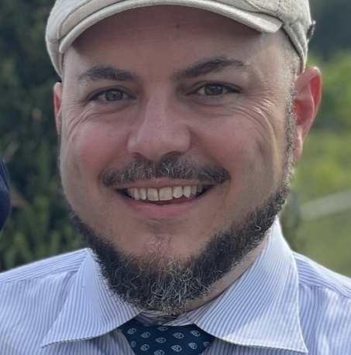


Project Team
UPDATE
Santiago Milian
Booz Allen VEO Program Manager
Kat Siedlecki Booz Allen VEO Portfolio Lead & HCD SME
Sara Snead VEO Lead
Ted Perez
Project Manager
Miriah Murphy
UX/UI SME
Juhi Ghosh
HCD SME

